Slide 1
Fault Tolerance and Failures in Reconfigurable Computing Devices
Mohammed El-Hadedy, Michael Bishara, Jinrun Liang, Juan Marquez, Arturo Murillo

Slide 2
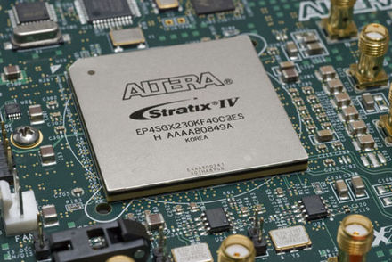
Introduction
Fault Tolerance: is the ability of computer software to continue its normal operation despite the presence of system or hardware faults.
Reconfigurable Computing: a computer architecture combining some of the flexibility of software with the high performance of hardware by processing with very flexible high speed computing fabrics like field-programmable gate arrays (FPGAs).
FPGA: an integrated circuit designed to be configured by a customer or a designer after manufacturing – hence the term "field-programmable" [1].

Slide 3
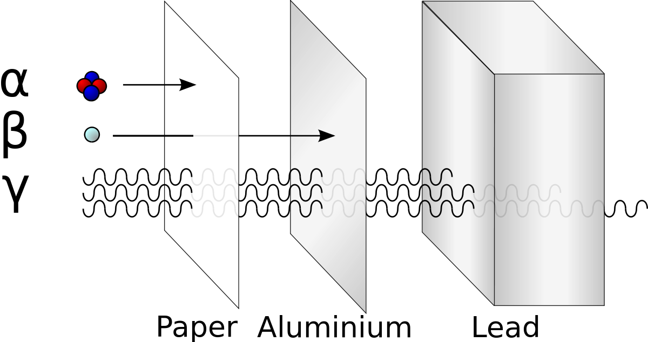
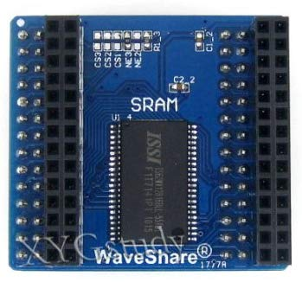
Background
In FPGA, the combinational and sequential logic are implemented in programmable Complex Logic Blocks (CLBs) which are conﬁgured by bitstream data. In order to store the bitstream, many FPGA devices are based on Static Random Access Memory (SRAM) [2].
However, an SRAM-based FPGA is vulnerable to radiation effects known as Single Event Effects (SEE) [3]. One of the most frequent is Single Event Upset (SEU) which causes the change in the state of a digital memory element and can cause undesirable change of function implemented in FPGA [4].

Slide 4
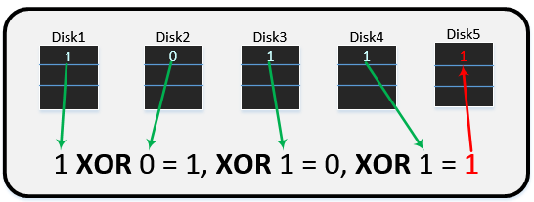
Similarity to Redundant Array of Inexpensive Disks
RAID 1: The concept of raid zero is to improve redundancy by having one hard drive mirror the data on a second hard drive to act as a backup in case one goes out.
RAID 5: Similar concept as RAID 1 but with the exception of having an XOR parity to replace one drive that fails.

Slide 5
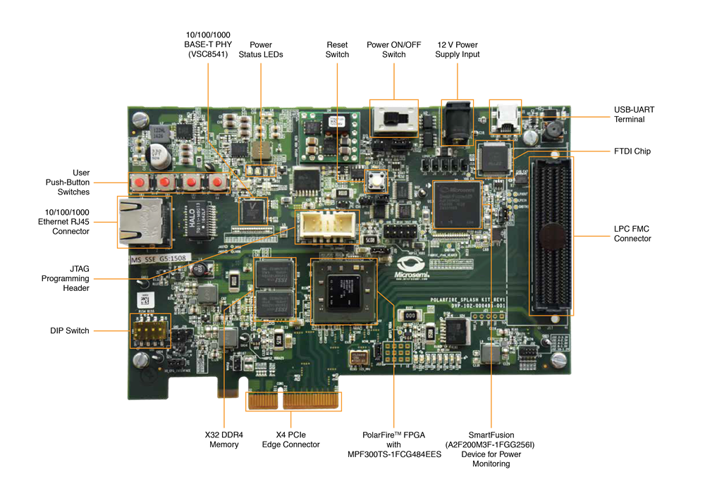
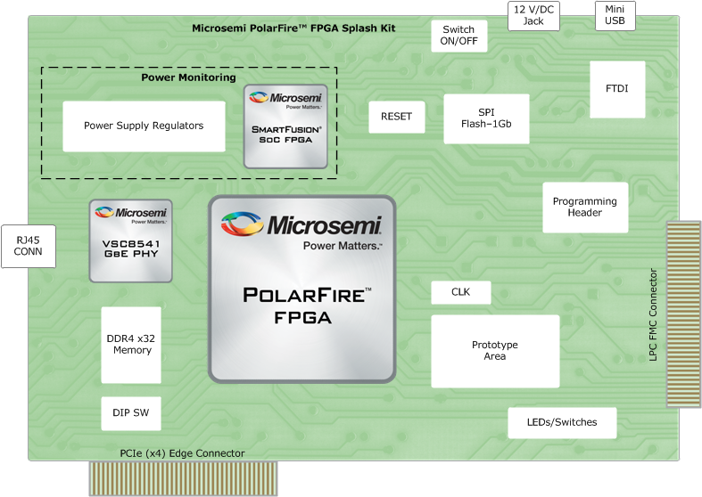
Requirements and Specifications
Microsemi's PolarFire Splash Kit provides general purpose interfaces for evaluation and development. The kit connections include Gigabit Ethernet RJ45, PCIe, USB and LPC FMC connector. A PolarFire 300K LE FPGA along with on-board DDR4 and SPI-Flash memory enable general purpose evaluations.
Software for creating the fault tolerant system (redundancy algorithm) [4].

Slide 6

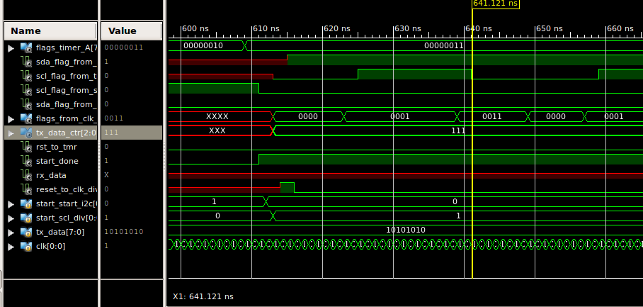
Constraints
Must utilize components within the Polar Splash Kit from Microsemi (Microchip) FPGA using it’s on board features.
Utilize Verilog, System Verilog and VHDL to implement the module repair algorithm through the Vivado hardware wrapper interface.
Cannot use actual radiation waves, must simulate the damage through scrambled bitstreams.
Cannot damage the board as it would be damaged if sent to space.

Slide 7
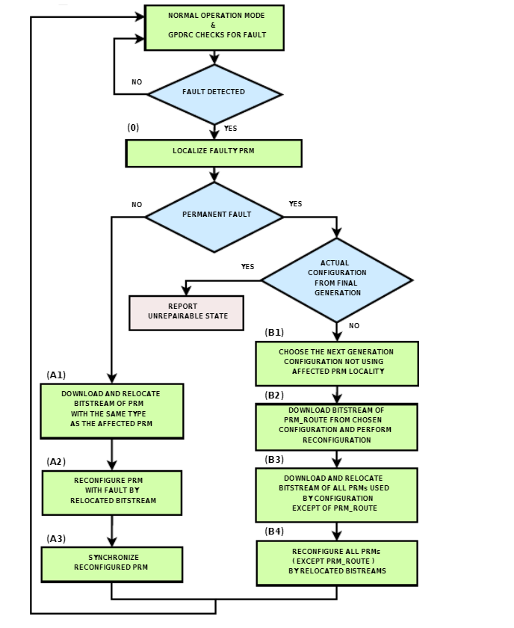
Design
The main design will be to have the board generate a bitstream, then send it as a bitstream output. From there, the bitstream will be given a fault or be scrambled and sent back to the board. The board will have to reconstruct the original signal it sent out using the reconstruction algorithm or deem it unrepairable. Partial reconfigurable modules (PRMs in the flowchart) and module redundancy will be used to repair the bitstream and hardware.

Slide 8
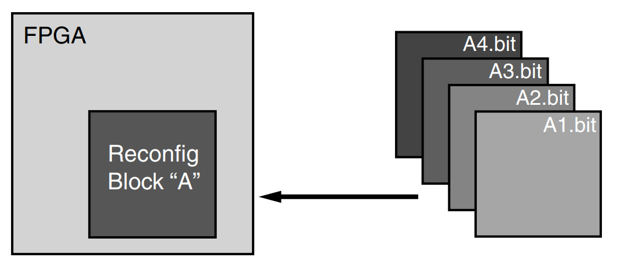
What are PRMs and Module Redundancy?
FPGA technology provides the flexibility of on-site programming and reprogramming without going through re-fabrication with a modified design.
After a full BIT file configures the FPGA, partial BIT files can be downloaded to modify reconfigurable regions in the FPGA without compromising the integrity of the applications running on those parts of the device that are not being reconfigured. This gives the ability to time multiplex hardware dynamically on a single FPGA [4].
Module redundancy ensures that the PRMs will not fail and can be restored to their previous states, similar to a RAID setup.

Slide 9
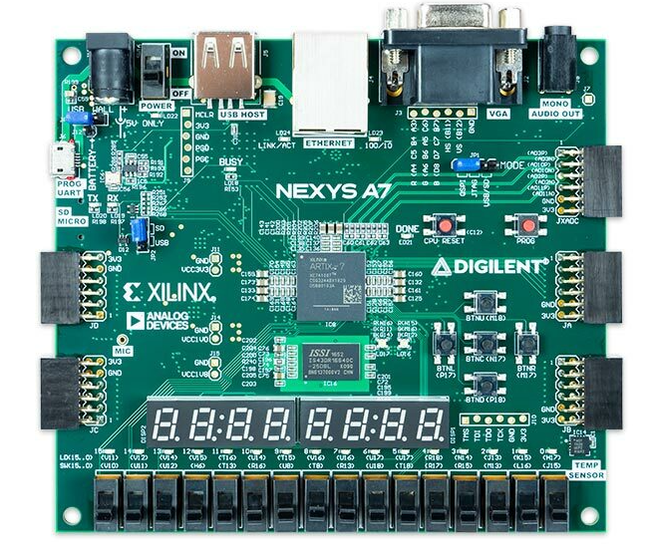
RISC-V on NEXYS 4 FPGA
RISC-V is one of the most popular open source processors.
Free to use with open source license
Wide range of use
Small, fast, and low-power implementation
High Redundancy
Nexys 4 – 100T board contains a Xilinx XC7A100T FPGA [Fig 7], providing an excellent platform of softcore processors.
Can implement RISC-V on Nexys4DDR FPGA
Easy to access
Programmed by Vivado

Slide 10
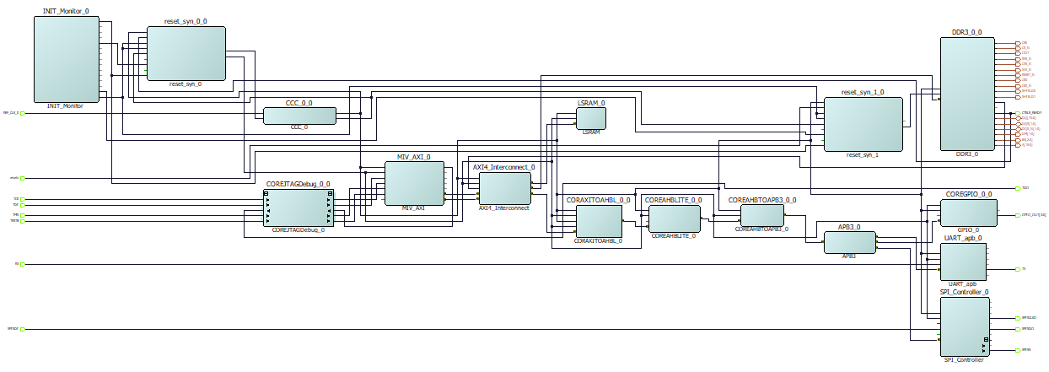
Implementation of RISC-V on PolarFire FPGA
Requirements
Silver License or better
Compile
Generate the bitstream
Libero V12.5 (or above)
Program the PolarFire
The goals of the implementation is to run RISC-V processor using Libero into the PolarFire

Slide 11
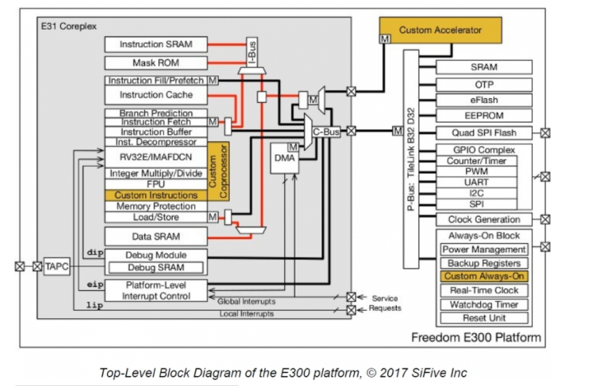
Implementation of RISC-V on NEXYS 4 FPGA
Requirements
Linux Machine (Virtual or Physical)
Compile
Generate the bitstream
Upload the applications
Vivado 2018.1 (or above)
Program the Nexys4
Basic Linux Environment (GIT)
Obtain the files from GIT CLONE
SD cards
Remote console installation for the Nexys4.
The goals of the implementation is to running a lowRISC processor in the Linux machine.

Slide 12

ABET Compliance
Primary Constraints: this can only really be marketed to NASA/JPL since it is intended for damages during space missions.
Project Planning: this project is set to be completed by the end of 2020 with the first prototype being completed around May.
Public Health: since the full scale version of this requires testing through rays of radiation, it may be hazardous to public health.
Environmental Impact: reduce the amount of hardware waste by rebuilding faulty hardware and bitstreams on a single FPGA board.
Economic Impact: save money by avoiding pricey radiation-hardened FPGA hardware that is currently used for space missions.

Slide 13
References
[1] U. Sharma, “Fault tolerant techniques for reconﬁgurable platforms,” in A2CWiC ’10: Proceedings of the 1st Amrita ACM-W Celebration on Women in Computing in India. New York, NY, USA: ACM, 2010, pp. 1–4
[2] L. Sterpone, M. Aguirre, J. Tombs, and H. Guzm´an-Miranda, “On the design of tunable fault tolerant circuits on sram-based fpgas for safety critical applications,” in DATE ’08: Proceedings of the conference on Design, automation and test in Europe. New York, NY, USA: ACM, 2008, pp. 336–341.
[3] G.-H. Asadi and M. B. Tahoori, “Soft error mitigation for sram-based fpgas,” in Proceedings of the 23rd IEEE Symposium on VLSI Test, ser. VTS ’05. Washington, DC, USA: IEEE Computer Society, 2005, pp. 207–212
[4] L. Miculka, M. Straka and Z. Kotasek, "Methodology for Fault Tolerant System Design Based on FPGA into Limited Redundant Area," 2013 Euromicro Conference on Digital System Design, Los Alamitos, CA, 2013, pp. 227-234.

